Slide 1
ForLens – A Lightweight AI-Driven Endpoint Security Solution for Real-Time Threat Detection in SMEs
Member Name | Comments | How it was addressed
MRF Nusfa | Quarantine notification mechanism should be implemented for the admin dashboard | Enhanced the system by integrating a structured event logging and notification mechanism for Quarantined files. These events can be used by the admin dashboard to trigger notification.
Salgado M B D | Good progress. Consider a better visualizing demo for the final presentation. | A Health Core visualization module was added to improve real-time anomaly insight and presentation clarity.
De Silva H S | Need a better way to demonstrate the tampering of the logs. Current implementation shows the dynamic chunking, but student unable to demonstrate the verification in an effective manner. | Added a live log tampering demo with side-by-side hash comparison view, clearly showing verification failure when a chunk is modified
Sanjula E A Y | Try integrating a knowledgebase of benchmarks to improve the TinyLLAMA recommendations in a standardadized manner. | Moved to cloud and knowledge base added

Slide 2
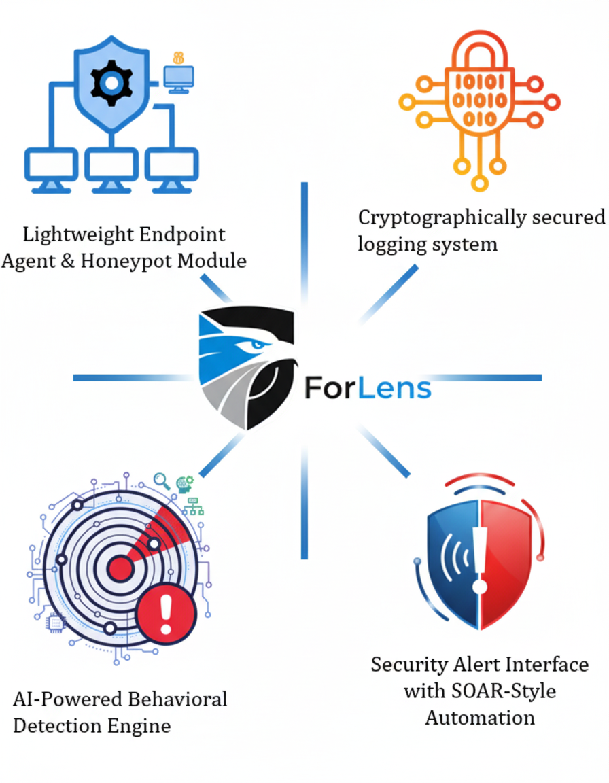
ForLens – A Lightweight AI-Driven Endpoint Security Solution for Real-Time Threat Detection in SMEs
PROBLEM AND DESIGN EXCELLENCE
Small and medium-sized enterprises (SMEs) face a growing risk from threats, both malicious and accidental.
Enterprise-grade security tools (e.g., SIEMs, EDRs, SOAR platforms) are either too resource-intensive, costly, or complex for SMEs to adopt.
Most enterprise grade solutions utilize AI & ML algorithms which are black box in nature.
Forensic logging systems are often centralized and prone to tampering, making it difficult to ensure trustworthy evidence during incident response.

Slide 3

IT22908742 | MRF NusFA
Lightweight Endpoint Agent Integrated with
Honeypot Module
The Lightweight Endpoint Agent monitors system activities including process execution, file operations, network connections and SMB honeypot access in real time. It performs signature-based detection by comparing file hashes against a predefined IOC database and automatically quarantines malicious files at the endpoint.
The system is implemented as a standalone executable enabling stealthy background execution. A watchdog mechanism ensures reliability by restarting the agent if it is terminated.
The agent supports offline operation where detection and containment are performed locally and logs are securely stored and synchronized once connectivity is restored. Additionally, log file recreation mechanisms ensure logging continuity in case of accidental deletion. Logs are transmitted securely to the backend using JWT-based authentication over HTTPS.
IT22908742 | <<MRF Nusfa>> | <<25_26J-076>>

Slide 4

IT21289934 | Salgado M B D
AI Powered Behavioral Detection Engine
Problem Addressed: Enterprise systems generate vast activity logs but lack effective behavioral analysis, making it difficult to detect insider threats accurately while minimizing false positives.
Solution : An AI-driven engine that learns normal user behavior and detects anomalies in real time. It integrates machine learning with threat intelligence to generate risk-based, explainable alerts for faster investigation.
Key Algorithms: Behavioral profiling is used to build dynamic user baselines,while anomaly detection (Isolation Forest and LSTM Autoencoders)identifies deviations. Feature engineering and a risk scoring modelenhance detection accuracy with threat intelligence correlation.
IT21289934 | <<Salgado M B D>> | <<25_26J-076>>

Slide 5

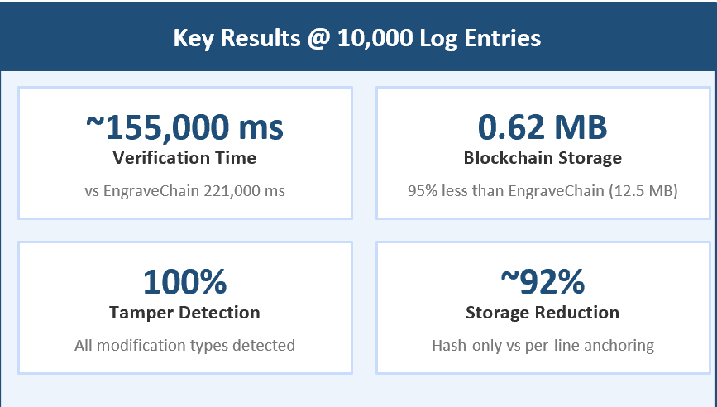
IT22887580 | De Silva H S
Cryptographically Secured Logging System
Problem Addressed: Modern distributed systems generate massive log data vital for security & forensics. Conventional storage lacks cryptographic tamper-evidence, leaving records vulnerable to adversarial modification.
Solution : A blockchain-anchored auditing framework on a private Ethereum PoA (Clique) network. Log entries are grouped, fingerprinted with SHA-256, and only digests are stored on-chain via a Solidity smart contract.
Key Algorithms: MonitorAndIngestLogs · GenerateSHA256Hash · WriteToBlockchain · LogStorage Contract · VerifyLogIntegrity
IT22887580 | <<De Silva H S>> | <<25_26J-076>>

Slide 6

IT22340078 | Sanjula E A Y
Security Alert Interface with SOAR-Style Automation
Problem Addressed: Dashboards are complex and is not understood by non technical persons. SME'S do not have resources to allocate to cyber security engineers and soc analysts. They often do not understand the outputs provided
Solution : An AI agent that can translate technical details into user friendly actionable outputs.

Slide 7
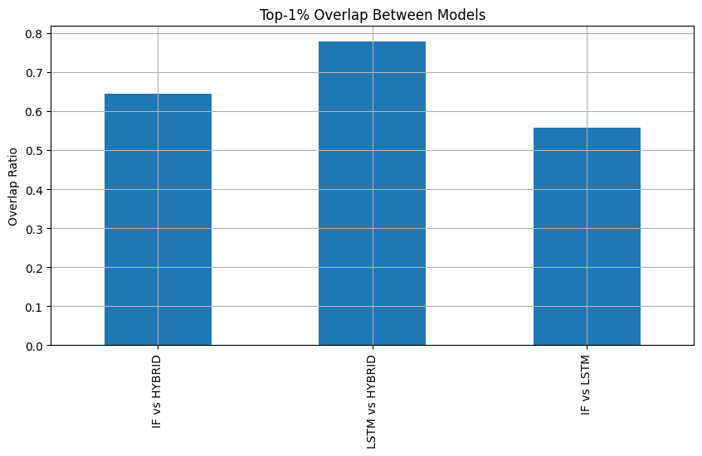
Benchmark Tests
We evaluated the performance of the endpoint agent in a controlled environment. The system achieved near real-time detection with latency below one second. CPU usage remained low between 2 to 5 percent, ensuring lightweight operation. All test malicious hashes were successfully detected and quarantined, demonstrating high detection accuracy. Additionally, the system maintained full functionality in offline mode, with reliable log storage and synchronization once connectivity was restored

Slide 8
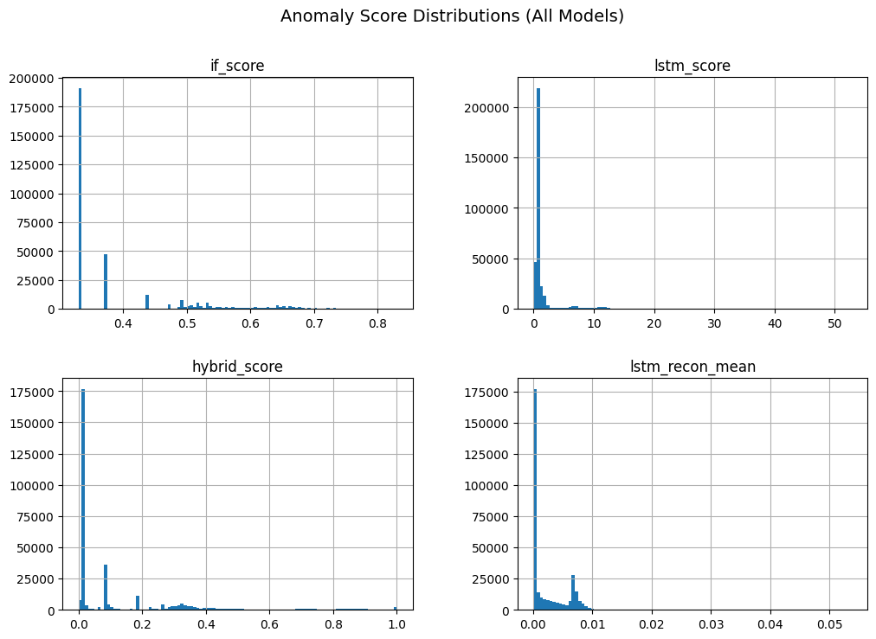

Slide 9
Limitations & Future Improvements
The demonstrations focused on controlled environments and the availability of open source data and tools. To prevent more advanced threats more research and comprehensive threat data need to maintained.
Tinly Lama LLM was utilized on the AI agent for non-technical translations, data insights and advice. However, the feasibility of using this LLM for multi-user high log ingestion environments need to be explored further.
Future improvements requires focus on improving the system to match the capabilities, speed and accuracy in high noise environments unlike SMEs. If product is enhanced to perform on high noise environments the product will be able to cater to the enterprise market as well with lower costs and with unique capabilities

